Slide 1

Group 11
POWERPOINT
Loan Prediction Based on Customer Behavior
Group Member: Jiazheng Qian, Huili Han

Slide 2

Catalogue
C O N T E N T S
Data set description
01
Data set description
Problems and Analysis
01
02
Group eleven
Group eleven
Further study
03
Further study
data app demo
03
04
Group eleven
Group eleven

Slide 3
Page 1
DATASITE DESCRIPTION
The purpose and commercial value of research.
Research Background
01
An organization wants to predict who possible defaulters are for the consumer loans product. They have data about historic customer behavior based on what they have observed. Hence when they acquire new customers they want to predict who is riskier and who is not.
Car
Ownership
House
Ownership
Marital
Status
Research Purpose
Job
Experience
02
Age
Income
Based on historical data, our group explore the factors that influence default rate, such as job seniority, asset ownership and age range.
Potential Factors Affecting Default Rate
Commercial Value
03
The research is helpful for enterprises to assess the risks of product delivery objects according to their attributes.

Slide 4
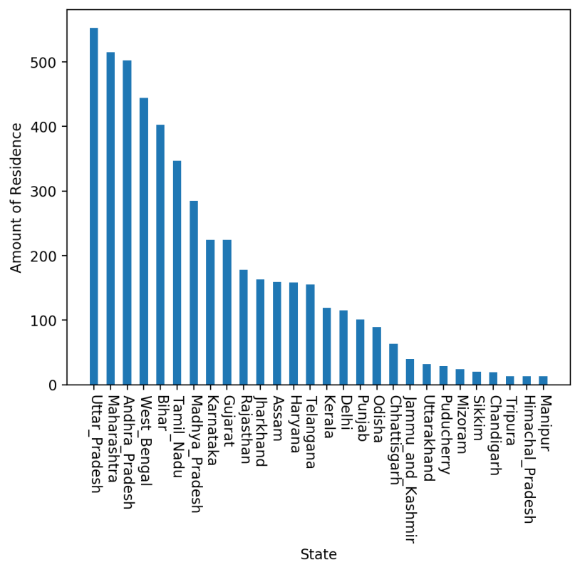
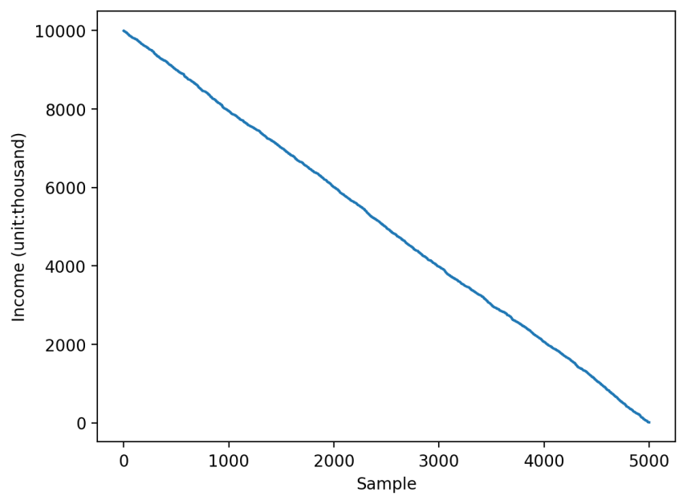
Page 2
DATASITE DESCRIPTION
The scope and objects of dataset.
Research Scope & Object
The data set covers 26 states around the world, including groups with an annual income between 10 thousands and 10 millions.
Fig 1-1 The Research Scope of Dataset
Fig 1-2 The Research Objects of Dataset

Slide 5
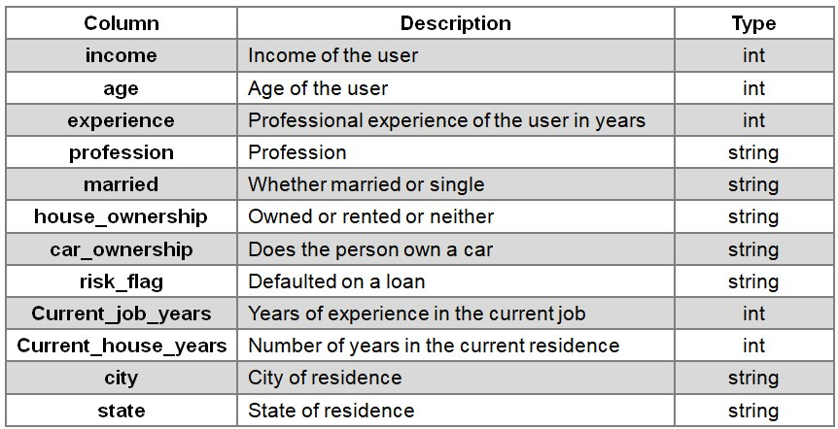
Page 3
DATASITE DESCRIPTION
The attributes of dataset.
The dataset contains 11 different attributes:
Fig. 1-3 The Attributes of Dataset
Our research mainly focus on the impact of income, age, job qualifications, marital status and ownership factors on the risk of default.

Slide 6


Page 4
DATASITE PREPROCESSING
Preprocessing the data to draw conclusions.
STEP 2
Deleting Duplicate Rows
Replacing the Null Value
Deleting Outliers
STEP 1
STEP 3

Slide 7
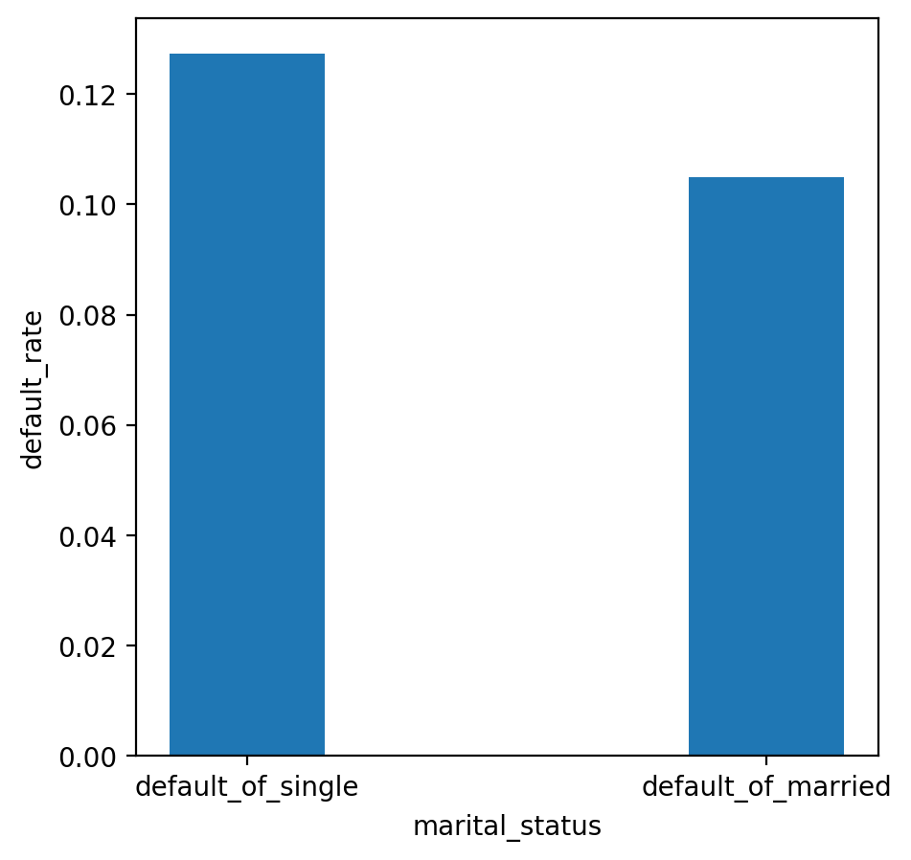
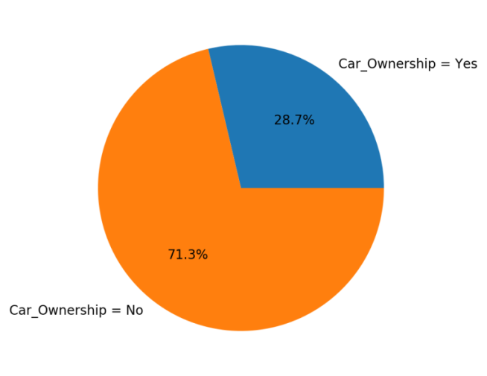
Page 5
Problem 1.1
Explore the potential factors affecting the default rate.
· Fig. 1-4 shows that the default rate of single people is higher than that of married people (the gap is about 0.022%).
· Fig. 1-5 shows that the default rate of the group that does not own the car (0.713%) is about 2.5 times higher than that of the group who own the car (0.287%).
Fig. 1-4 Default Rate of Groups with Different Marital Status
Fig. 1-5 Default Rate of Groups with Car Ownership & Without

Slide 8
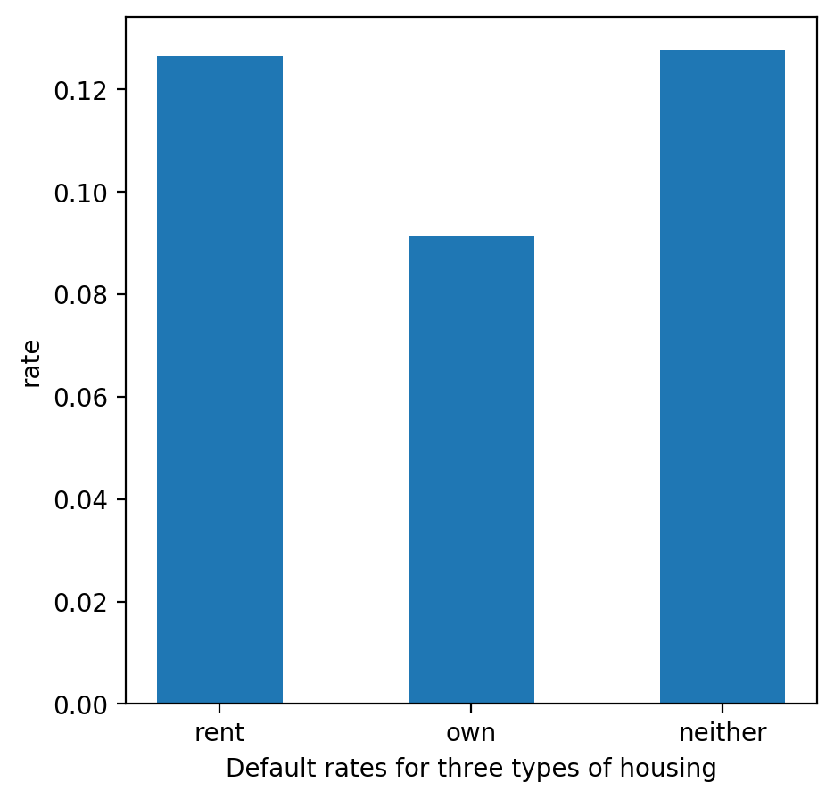
Page 6
Problem 1.2
Explore the potential factors affecting the default rate.
· Fig. 1-6 shows that the default rate of rental groups (12.655%) is higher than that of homeowners (9.127%).
Conclusion
Marital status and asset ownership (house and car) are correlated with default rate, and groups with lack of asset ownership or single marital status are more likely to be default.
Fig. 1-6 Default Rate of Groups with House Ownership & Without

Slide 9
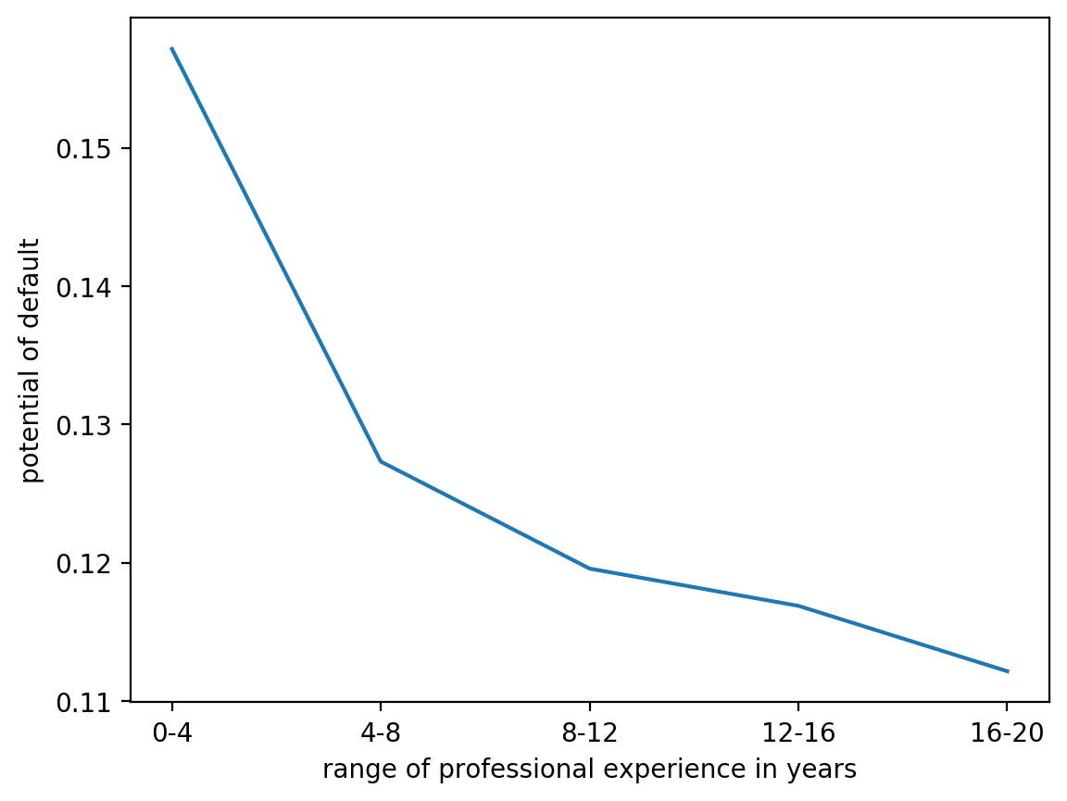
Page 7
Problem 2.1
Relationship Between Profession Experience and Default Possibility
Figure Analysis
The figure (Fig. 2-1) shows that there is a significant negative correlation between years of work experience and default rate.
The group with 0-4 years of work experience had the highest default rate (15.716%), and the group with 16-20 years of work experience had the lowest default rate (11.214%).
Fig. 2-1 Default Rate of Groups with Different Professional Experiences

Slide 10
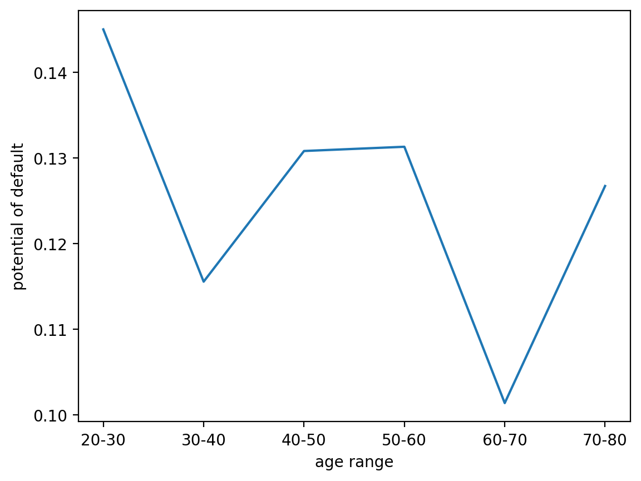
Page 8
Problem 2.2
Default Ratio of Different Age Groups
Figure Analysis
The picture does not show a clear relationship between default rates and age
The default rate is the lowest in 60-70 age group(10.138%) and the highest in20-30 age group(14.504%).The gap between the default rate of 40-50 and 50-60 age groups is small(about 0.0004948).
Fig. 2-2 Default Rate of Groups with Different Age

Slide 11
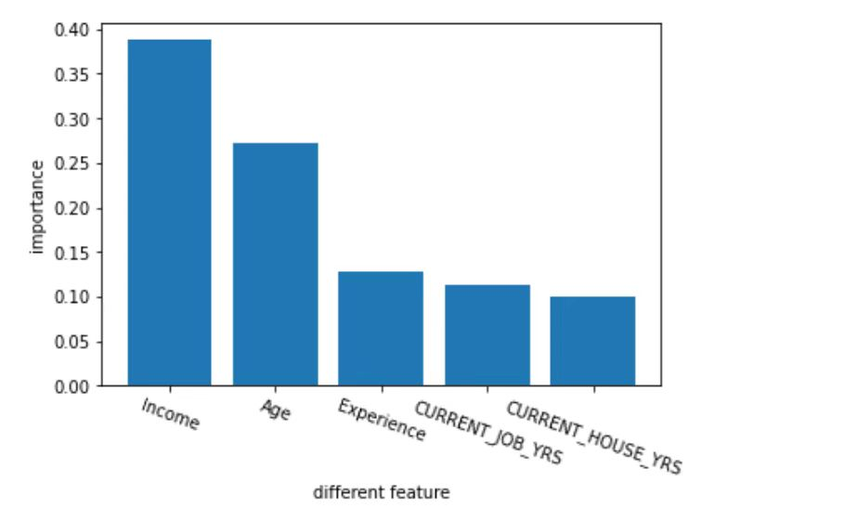
Page 9
Further study
Random forest algorithm
01
Algorithm
Using the random forest algorithm to rank the importance of some features
Training set: Test set = 7:3
02
The ranking result
The importance of these features on the impact of loan default results is ranked as follows:
1.Income 2.Age 3.Experience 4.Current_job_years 5.Current_house_years
03
Predicted results
Score for the training data set : 98.29%
Score for the testing data set : 87.87%
Fig. 2-3 The Importance of Different Factors Affecting Default Rate

Slide 12
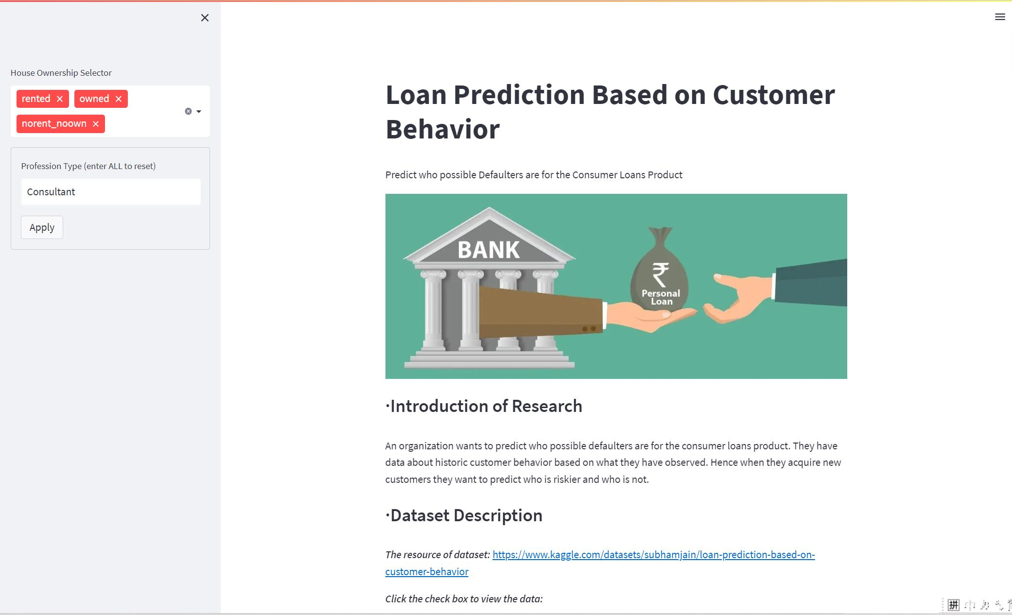
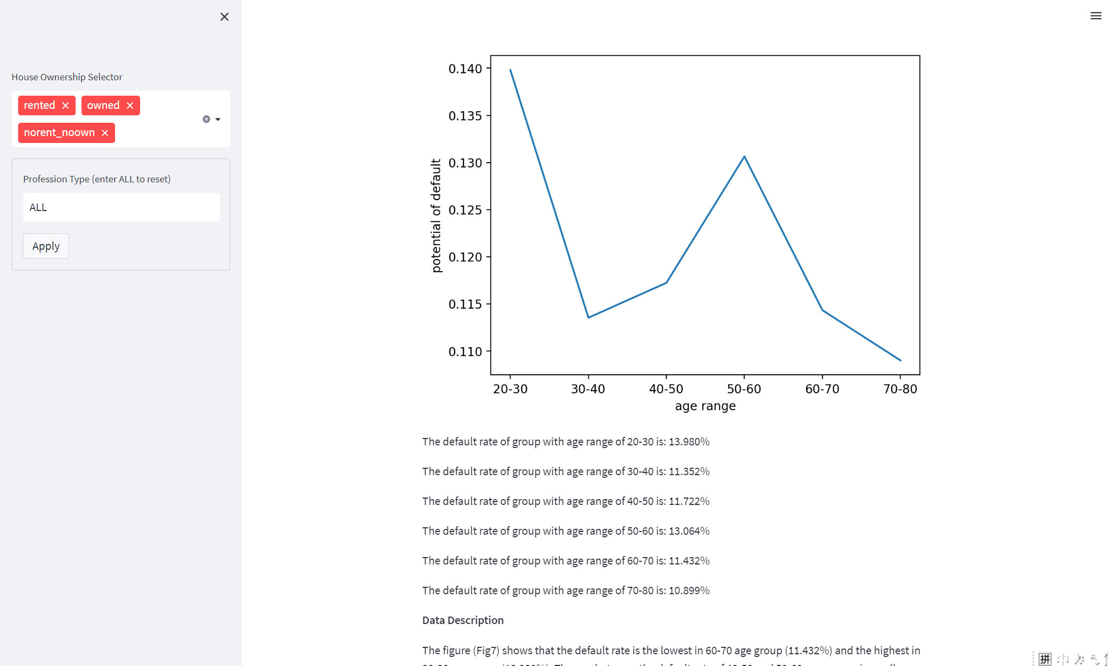
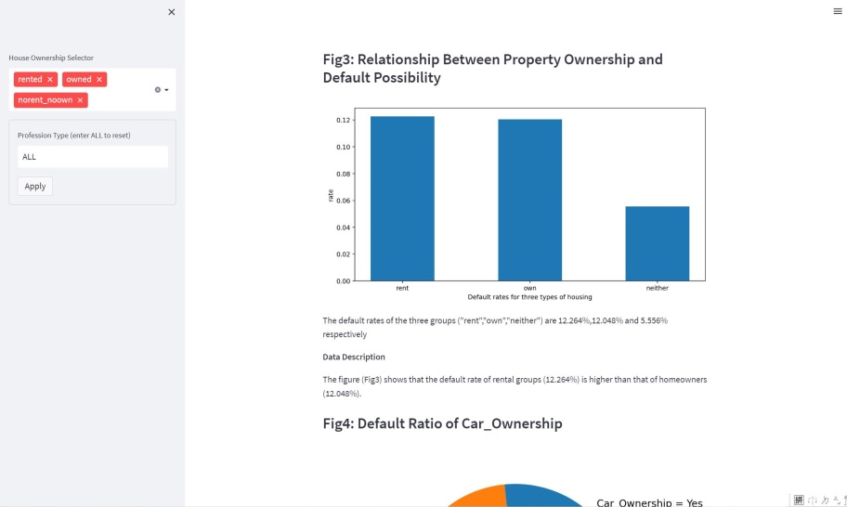
Data app demo show
Two filters

Slide 13


Data app demo show
Two filters

Slide 14

Data app demo show
Two filters

Slide 15

Group 11
POWERPOINT
THANK YOU

